Slide 1


Multi-Class Animal Recognition
Name :Mounika S
AICTE Student ID: STU646605d61dcd31684407766

Slide 2

Learning Objectives
Understand the role of AI in wildlife conservation
Learn multi-class animal image classification techniques
Apply deep learning models (CNNs) to identify animal species
Explore real-world datasets and evaluation metrics
Develop a basic recognition system for conservation support
GOAL
Source :
www.freepik.com/

Slide 3
Tools and Technology used
KaggleHub: For downloading the animal image dataset.
TensorFlow / Keras: Deep learning framework for model building and training.
MobileNetV2: Pre-trained CNN model used for transfer learning.
ImageDataGenerator: For image preprocessing and augmentation.
Matplotlib: To visualize images and results.
NumPy: For numerical operations.
GPU (if available): To speed up model training.

Slide 4
Methodology
Dataset Collection: Collected animal images from Kaggle using KaggleHub.
Data Preprocessing: Resized, normalized, and augmented images using ImageDataGenerator.
Model Selection: Used MobileNetV2 for transfer learning to improve accuracy and reduce training time.
Model Training: Trained the model with preprocessed data using TensorFlow/Keras.
Evaluation: Evaluated performance using accuracy, loss, and sample predictions.
Result Visualization: Plotted training history and sample outputs using matplotlib.

Slide 5
Problem Statement:
The accurate classification of animals from images is a crucial task in wildlife monitoring, biodiversity research, and educational tools. Traditional manual methods are time-consuming and prone to human error. Therefore, the aim is to develop a deep learning-based image classification model that can automatically recognize and classify animals from given images with high accuracy, using transfer learning techniques like MobileNetV2.

Slide 6
Solution:
Data Collection: Gathered animal images from Kaggle and Google sources.
Preprocessing: Resized, normalized, and augmented images to enhance model performance.
Model Selection: Used MobileNetV2 with transfer learning for efficient training.
Training & Validation: Split dataset into training and validation sets, optimized using Adam optimizer.
Evaluation: Achieved high accuracy and precision using metrics like confusion matrix and classification report.

Slide 7
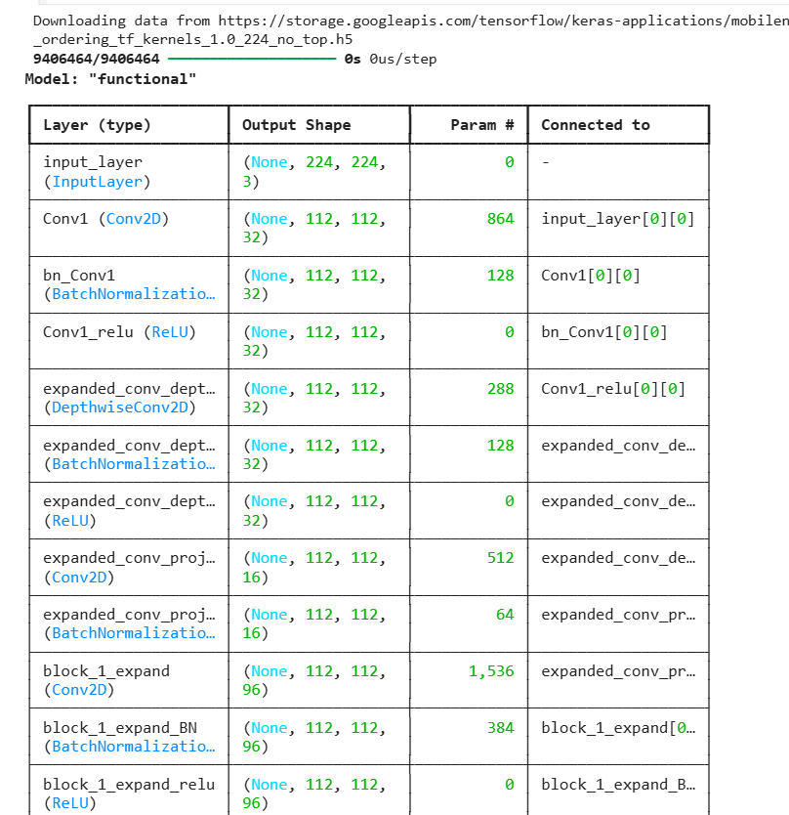
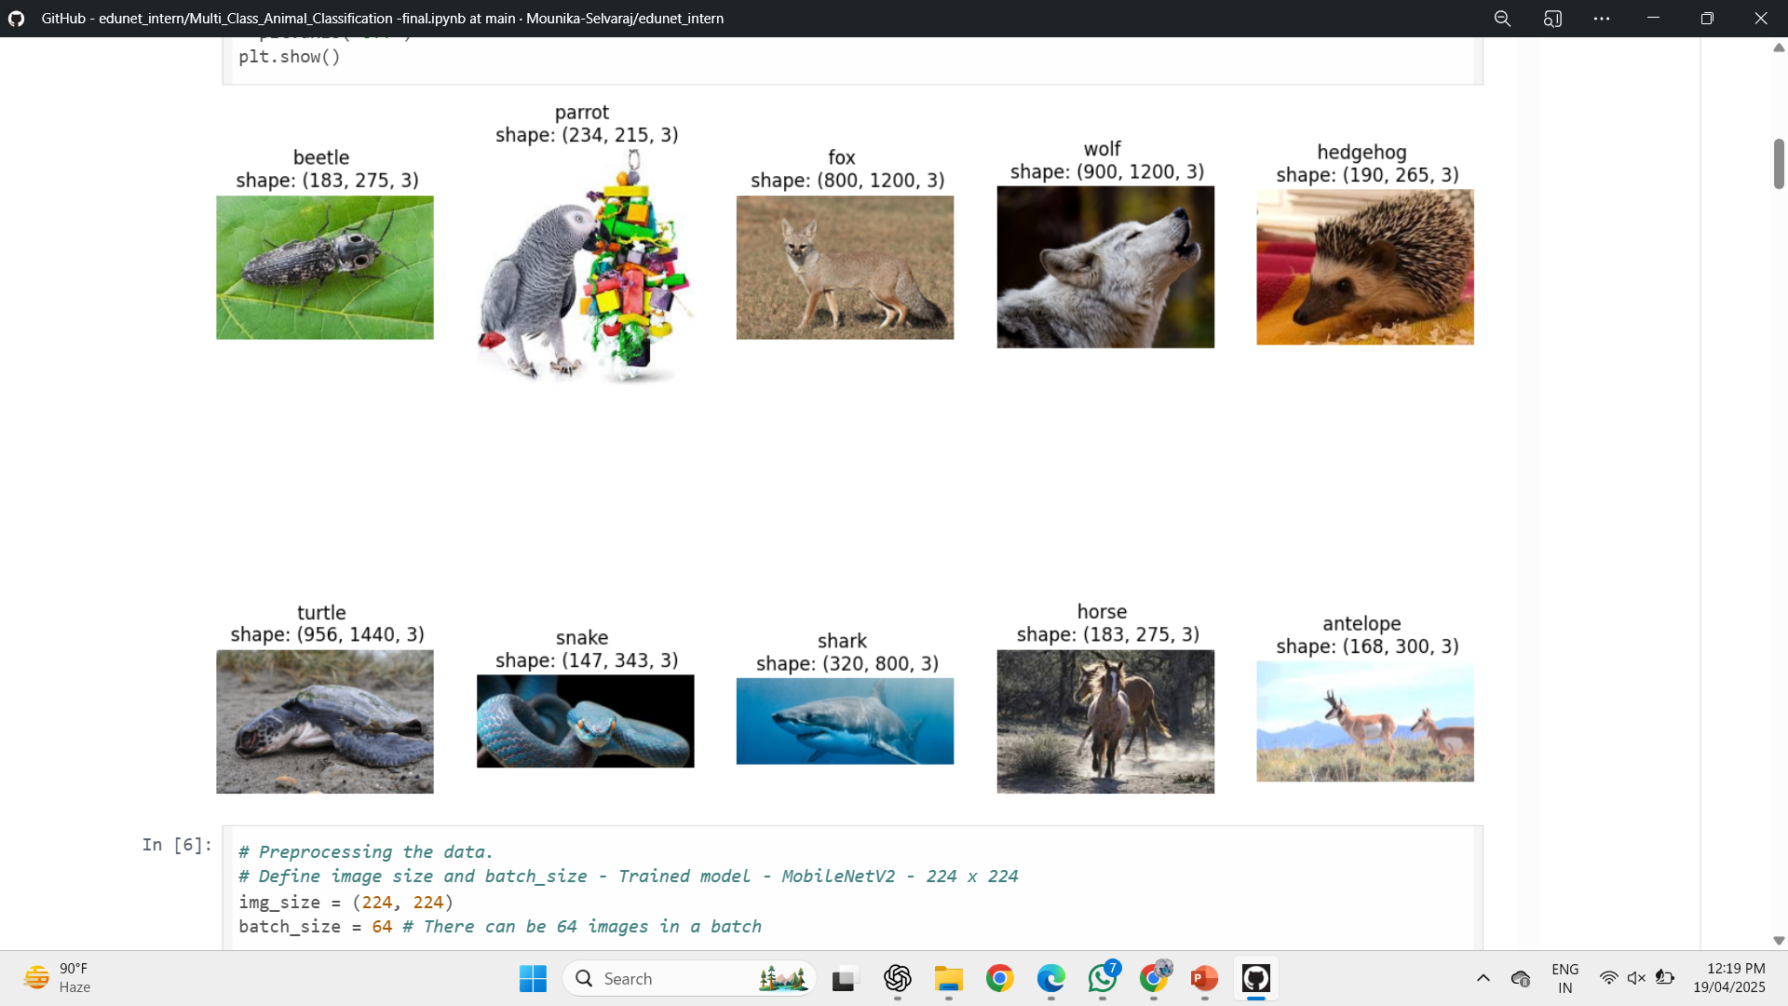
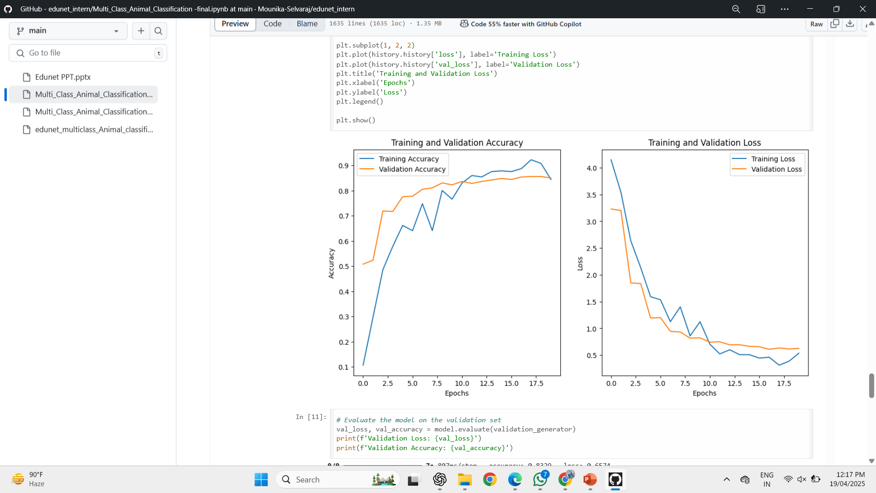
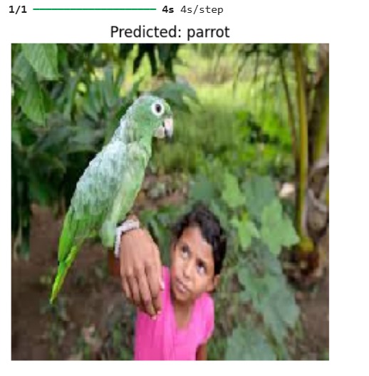
Screenshot of Output:

Slide 8
Conclusion:
The code successfully downloads and processes the "Animal Image Dataset" consisting of 90 animal classes. It verifies the use of the GPU for training, lists the animal classes, and visualizes some sample images from the dataset. The data is preprocessed using ImageDataGenerator with data augmentation for training and validation. The dataset is ready for model training using a pre-trained MobileNetV2 model, with further steps for building, compiling, and evaluating the model to classify the animal images.

